Slide 1
Deliverables
Flag in project form that identifies if a project is eligible for to be used as a benchmark data source
Auto-select based on criteria
Ability to overrule
Add as workflow switch (if prodcat=.. And … and switch = true→benchmarking data is mandatory to be filled in.
A new widget to collect more data such as total m2 of buildings, nr of pallets etc..
Works the same way as current financial indicators, responds to change requests
Implement value realization widget from Uppwise
Add a new column to enter total investment per VR, IF the VR is non-tangible
Migrate existing sustainability data
Add VR datasource to the dashboard
Rebuild sustainability dashboards to support phased values and new datasource
Include in (re-)baseline process

Slide 2
Deliverables
Build project form benchmark popup(next slide)
Collects benchmark data from benchtable, see next slides and compares project benchmarks
Ability to un-select projects to be excluded from comparison table →refreshes the benchmark
Shows graphical indicators for performance
Gives recommendation, for example using weighting per benchmark item

Slide 3
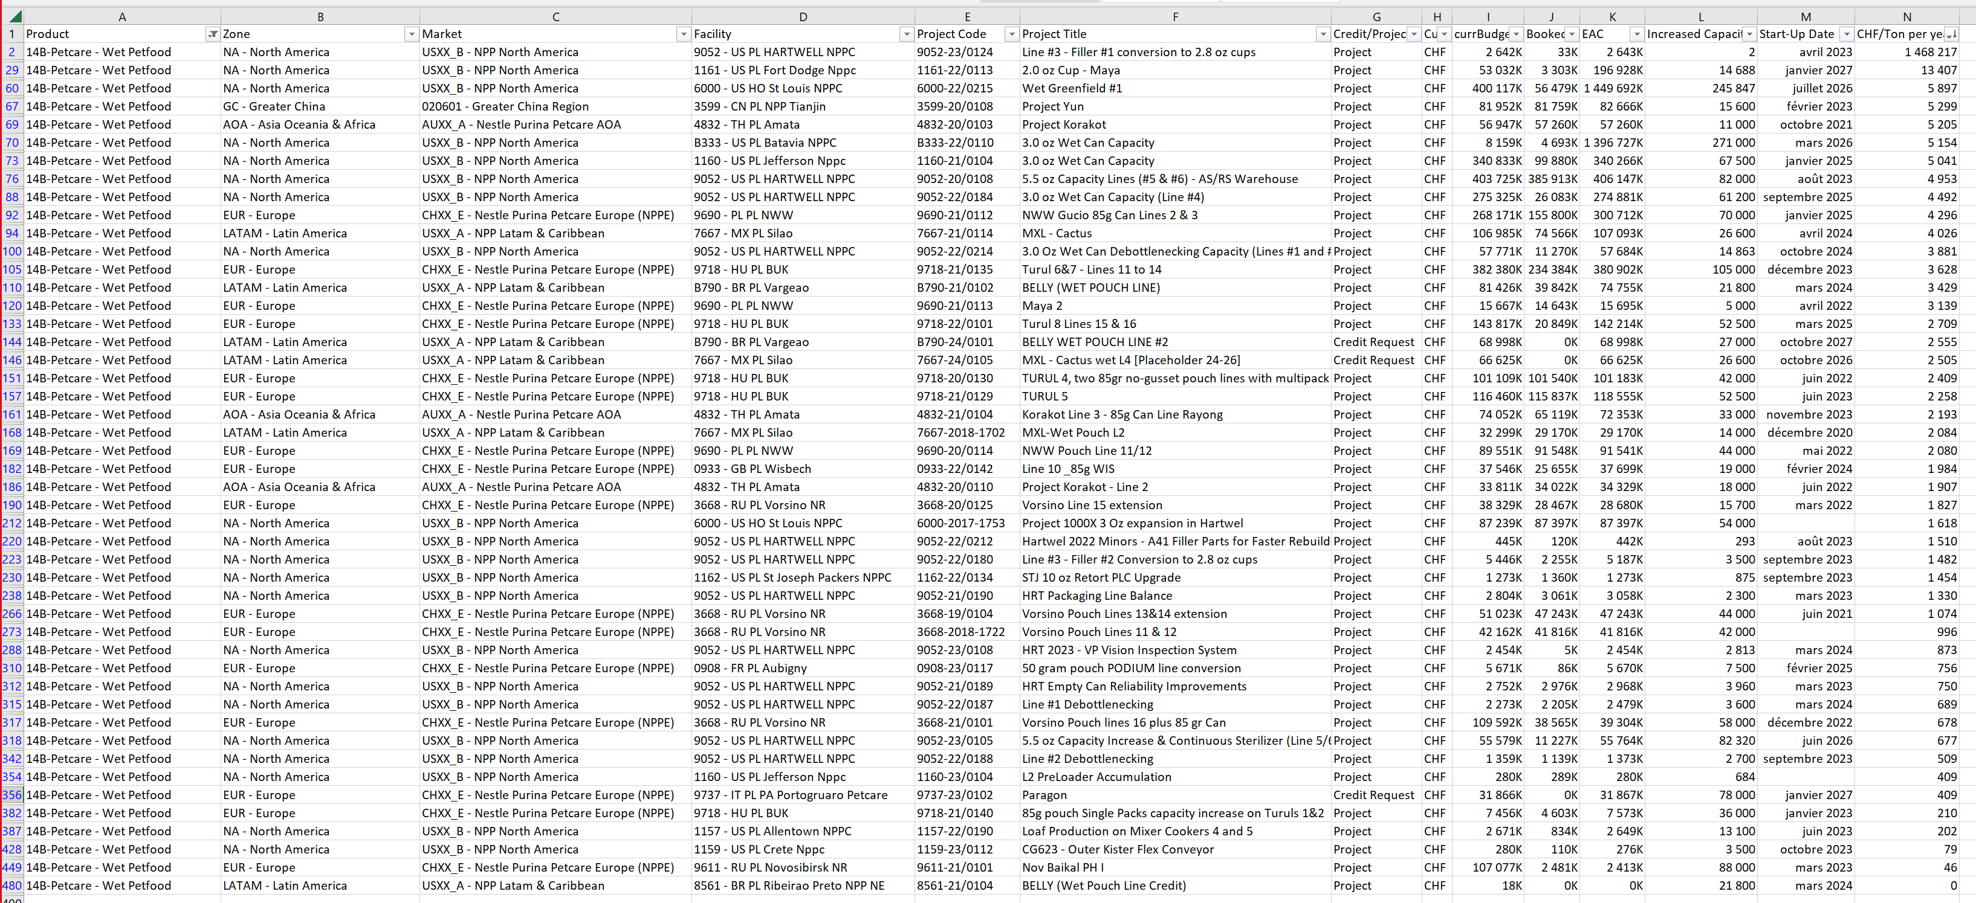
Popup to be called from the project form
Select years to include : 2020 to 2026
Project
International Benchmark
1200 CHF / ton
1400 CHF / ton
Unselect projects you wish to exclude for this benchmark
1200 CHF / m2
1000 CHF / m2
1200 CHF / CO2
1000 CHF / CO2
Recommendation : Recommend

Slide 4
Deliverables
Admin module
Benchmark table with benchmark data
Ability to import
Ability to modify if needed
Ability to configure type of benchmarks?
Contains both imported international data from import and project data derived from NIMT
Dashboards
New datasource for the benchmarking data
New datasource or change for project summary extended content
Rebuild existing dashboards, and build new ones
Reports?

Slide 5
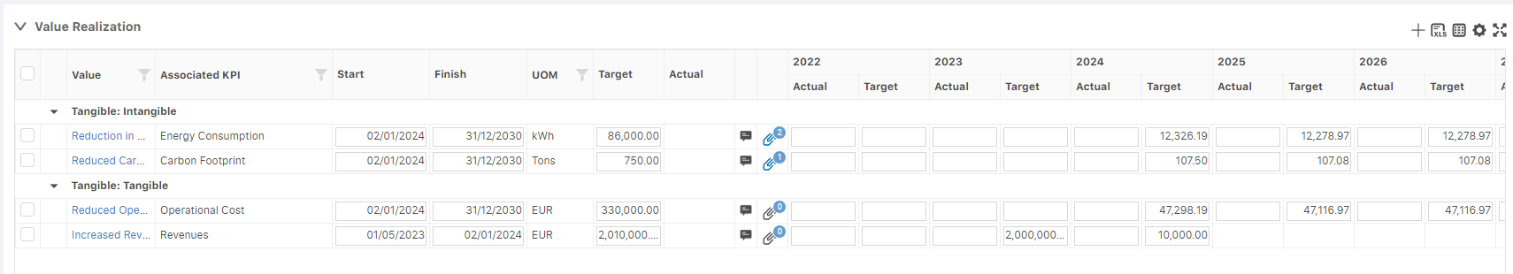

Slide 6
